Slide 1
Business Communication System
initial discussion

Slide 2
Team Members
Aymen Alswidi
Rasheed Almekhlafi
Abdulrahman Ali
Emad Alfaqih
Aymen Almuraish
Odai Farhan
Esmaeel Alsaman

Slide 3
Background
Business communication system is a system that provides communication services within a local network, works on the Microsoft Windows platform , the application provides three main services which are voice communication, text messaging and file sharing.
Voice communication allows the exchange of communications between two users connected to the same LAN network using various network protocols.
Messaging allows the user to exchange messages with any other user linked in the same LAN network.
File transfer allows the exchange of files (doc, pdf, video, image) over the LAN network.

Slide 4
Problem Background
PBX phone systems were created to solve the problem of communication between parties in the organizations, and then chatting applications were created to solve the problem of the great number of post office reporters.
Then PBX phone system cause many problems due to the need of frequent maintenance and increased size of organizations lead to complexity of PBX networks which increase time and cost of maintenance.
PBX phone systems infrastructure take space and cost to be installed.
Large proportion of the resources available in the organizations are untapped.

Slide 5
Problem Statements
The cost of creating , maintaining and expanding of PBX phone system.
PBX is limited to providing voice communication only.
Large proportion of the resources available in the organizations are untapped.
Need of various services of communication inside organizations.

Slide 6
Objectives
Eliminate the electric shunt and wired connections within the organization by adding the voice communication service through the system that installed on computers and works via existing LAN network.
Reducing cost of implanting new Communication infrastructure.
Providing several services for communication.
More and better use of the computer systems.

Slide 7
Assumptions and Dependencies
Hiring an expert in programming the network protocols.
Dividing business among team members.
Insert a mobile internet provider
Borrowing devices that meet the required standards

Slide 8
Scope
Institutions and companies.
Small or Emerging business.

Slide 9
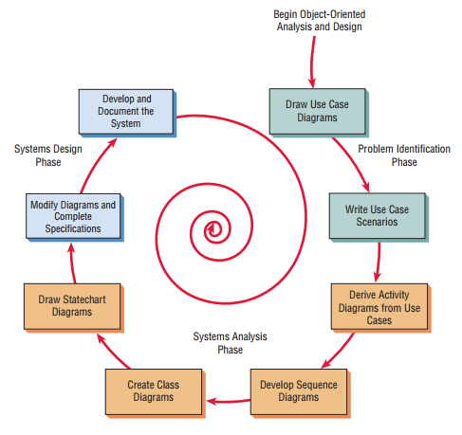
Life Cycle Model
Figure 1.1 Object Oriented life cycle which used to facilitate the development of systems that change rapidly in response to dynamic business environments.
Notes:
Alternate approach to the structured approach of the SDLC that is intended to facilitate the development of systems that change rapidly in response to dynamic business environments
Analysis is performed on a small part of the system followed by design and implementation.
The cycle repeats with analysis, design, and implementation of the next part and this repeats until the project is complete.
Examines the objects of a system.

Slide 10
Requirement specifications User Requirements
Ease of use by providing simple user interfaces which make user recognizes them quickly.
High security while data transmitted back and forth.
High performance at processing requests.

Slide 11
Requirement specifications Functional Requirements
Making Calls
File Sharing
Instant Messages

Slide 12
Requirement specifications Non-Functional Requirements / Usability
The Application offers easy and simple graphical interfaces, which means user can understands and uses the application easily which result in obtaining user satisfaction.

Slide 13
Requirement specifications Non-Functional Requirements / Dependability
Dependability
The application effectively carries out all tasks that mentioned in the functional requirements so that it performs tasks quickly and accurately.
Robustness
The application can handle with errors, which cannot lead to failure. For example, if the user enter invalid datatype of a particular field it shows an error message to inform the user that there is an error and how to fix the error.
Safety
The application does not pose any risks at worst because it is not kind of critical systems, which consider safety as an important factor to keep running.
Security
The application is difficult to be tracked by any external entity because connecting to the internet is not required and working only at the organization's local network and the administrator have all privileges to do what is needed if there is any violations or breaches.

Slide 14
Requirement specifications Non-Functional Requirements / Performance
Response Time
It has been considered that response time should quickly even if in the peak time, but there are several factors to determine response time such as hardware infrastructure, number of users, geographical space and other factors not mentioned.
Throughput
It depends on process type that is required to be performed in addition to the network response.
Availability
The application must be available when the device is connected to the network.
Accuracy
The application is accurate as it sends only valid data and if there is an error user is informed.

Slide 15
Requirement specifications Non-Functional Requirements / Supportability
Adaptability
The application is compatible with computers that working on Microsoft Windows or smart phones working on Android.
Maintainability
The application is flexible, so it is possible to add, remove, or modify services and updates available by developers of the application and easily solving problems when they occur.
Internationalization
The application is universal as it supports Arabic, English language and any other languages ​​if needed.
Portability
The application can be moved to another environment if one condition is met, in which the previous and new environment infrastructure is the same.

Slide 16
Requirement specifications Non-Functional Requirements / Validation
Completeness
The application is integrated, in terms of user can interact with others within the organization by making voice calls and sending or receiving messages.
Consistent
There is no conflict between elements and other processes because it cannot occur any overlap in executing processes among users, which performed separately and accurate to ensure that processes are not overlapped.
Unambiguous
The application is clear and does not contain ambiguity.
Correctness
The program works according to criteria that ensure work continuation with high accuracy and reliability to avoid problems and errors that may occur.

Slide 17
Requirement specifications Non-Functional Requirements / Other
Verification
The application undergoes several rigorous tests to ensure the safety of the application in terms of performance and processing.
Realistic
The application is realistic that it implements requirements under restrictions.
Traceable
The application can be traceable, that all processes are recorded in central database which allows administrator to check records if problems happened.

Slide 18
THE END

Slide 19
